Slide 1
Generative Adversarial Networks
By Yaohang Li, Ph.D. Department of Computer Science Old Dominion University yaohang@cs.odu.edu

Slide 2
Generative Adversarial Network (GAN)
Adversarial Learning
GAN Architecture
DCGAN
GAN Applications
The Fundamentals of GAN
FAT-GAN

Slide 3
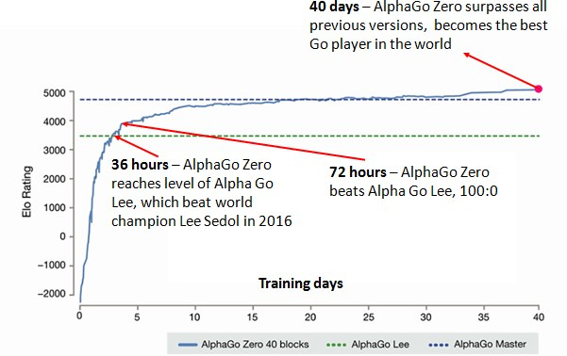
Adversarial Learning
AlphaGo
Convolutional Neural Network (CNN)
AlphaGo Zero
Adversarial Network
Source: DeepMind

Slide 4
Generative Adversarial Network (GAN)
Generative Adversarial Networks (GAN)
Introduced by Ian Goodfellow et al. in 2014
Deep neural network architectures comprised of two nets
A Generator
A Discriminator
Both nets are trying to optimize a different and opposing loss function in a zero-zum game
Potential of GAN
Can be trained to mimic any distribution of data
Create worlds eerily similar to our own in any domain
“The most interesting idea in the last 10 years in machine learning” – Yann LeCun

Slide 5
Generative Adversarial Network (GAN)
Adversarial Learning
GAN Architecture
DCGAN
GAN Applications
The Fundamentals of GAN
FAT-GAN

Slide 6
General Architecture of GAN

Slide 7
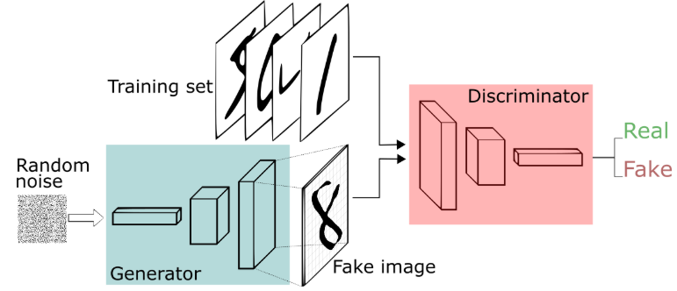
A GAN Example
Generating Hand-writing Digits
mage credit: Thalles Silva

Slide 8
Step by Step GAN

Slide 9
Training a Discriminator
Binary Discriminator

Slide 10
Training the Generator
Try to Fool the Discriminator

Slide 11
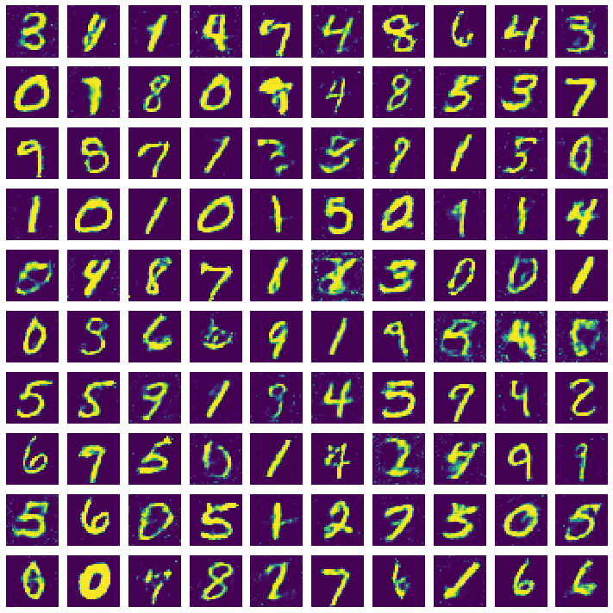
Demo: MNIST GAN
Jupyter notebook GAN_MNIST.ipynb

Slide 12
Generative Adversarial Network (GAN)
Adversarial Learning
GAN Architecture
DCGAN
GAN Applications
The Fundamentals of GAN
FAT-GAN

Slide 13
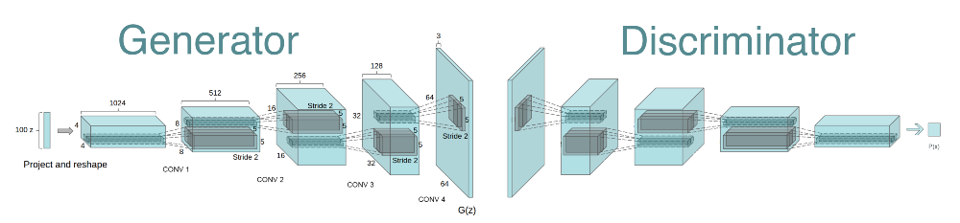
Deep Convolutional GAN (DCGAN)
Improve the sensitivity of Discriminator
Improve the approximation of Generator
Radford, Alec, Luke Metz, and Soumith Chintala. "Unsupervised representation learning with deep convolutional generative adversarial networks." arXiv:1511.06434 (2015).

Slide 14
DCGAN Architecture
Convolution Layer in both Discriminator and Generator
Strided Convolution (Discriminator)
Fractional-strided Convolution (Generator)
Batch Normalization
Remove Fully-Connected Hidden Layers for Deeper Architecture
ReLU in Generator except for output (Tanh)
LeakyReLU for Discriminator

Slide 15
DCGAN on MNIST

Slide 16
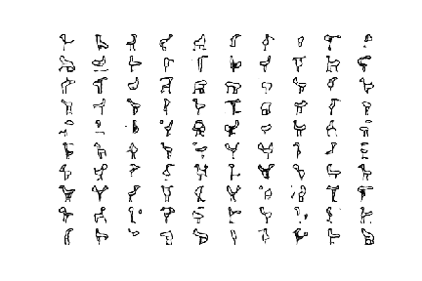
Demo: Using GAN to draw your own flamingo
Jupyter notebook GAN_flamingo.ipynb

Slide 17
Generative Adversarial Network (GAN)
Adversarial Learning
GAN Architecture
DCGAN
GAN Applications
The Fundamentals of GAN
FAT-GAN

Slide 18
The Power of GAN
Can be trained to mimic any distribution of data
Applications
Artificial Arts
Virtual Reality
New Characters
Artificial Music

Slide 19
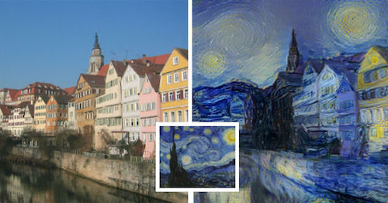
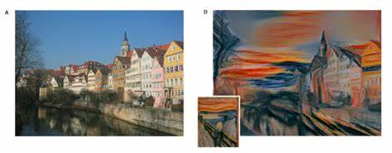
Generating Virtual Arts
http://www.businessinsider.com/robot-can-paint-as-well-as-van-gogh-2015-9

Slide 20
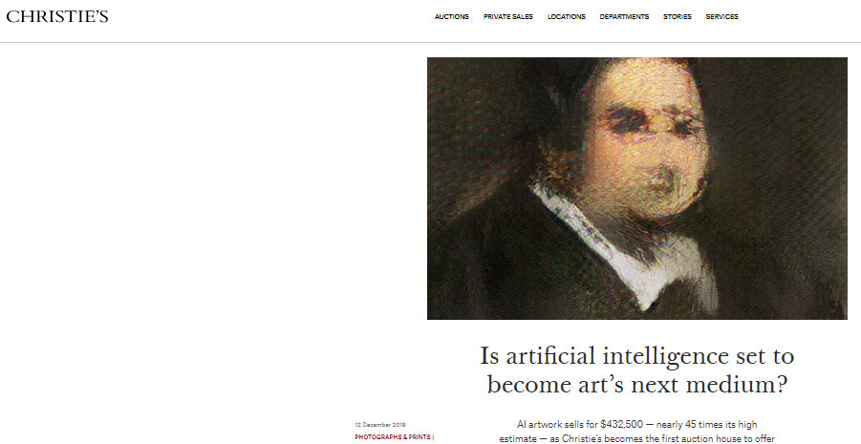
AI Arts
AI arts sold for $432,500 in Christie’s

Slide 21
Virtual Reality
Source: Metz and Collins, 2018

Slide 22
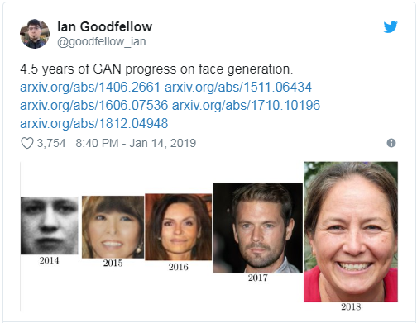
4.5 Years of GAN Progress on Face Generation

Slide 23

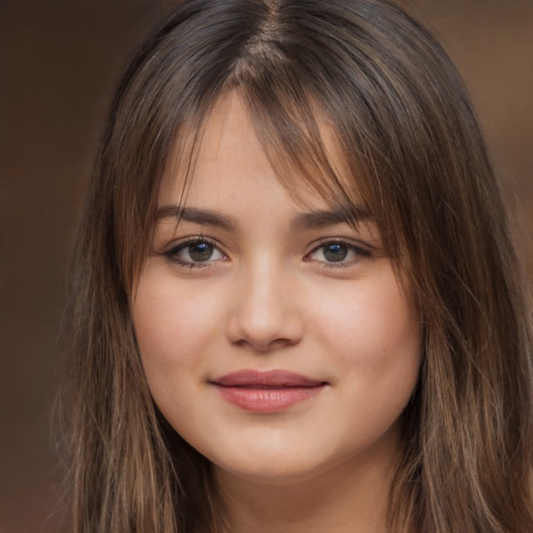
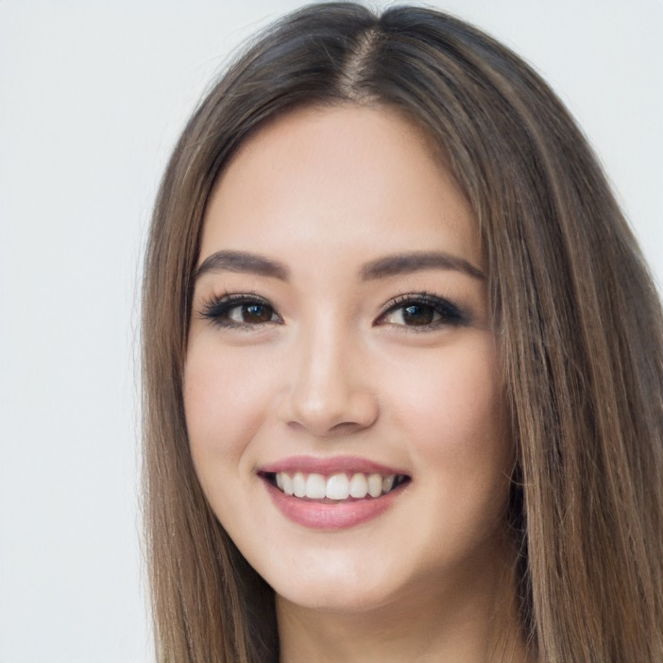
GAN Face Generation Today
https://www.thispersondoesnotexist.com/

